Slide 1

CAPSTONE PROJECT -2
EMPLOYEE CHURN PREDICTION

Slide 2

CONTENTS
Group MEMBERS
MEETING SCHEDULE
METHODOLOGY
EDA
MODELING
Logistic Model
K-Means
KNN
Gradient Boosting
Random Forest
XGBoost
ANN
Model Evaluation
Model Deployment

Slide 3
GROUP MEMBERS
DA2101 - Oğuzhan
DA2102 - Birgül
DA2103 - Pakize

Slide 4
MEETING SCHEDULE
24.10 EDA & Data Visualization
25.10 Logistic Model & K-Means Modelling & KNN
26.10 Gradient Boosting & Random Forest
27.10 XGBoost & ANN
28.10 Review

Slide 5
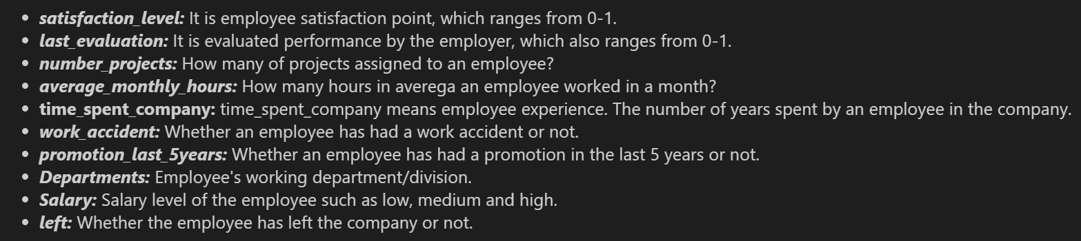
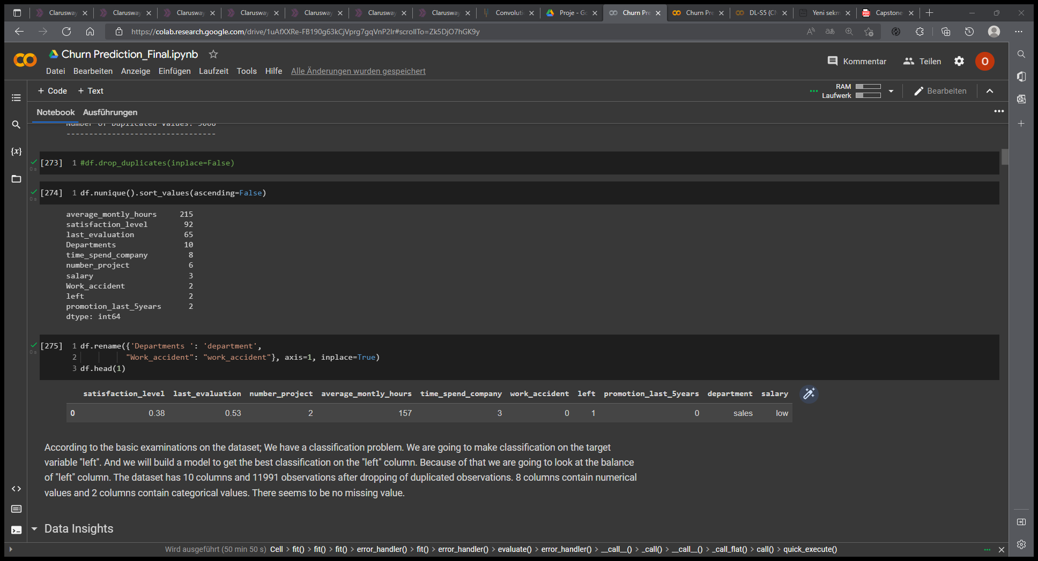
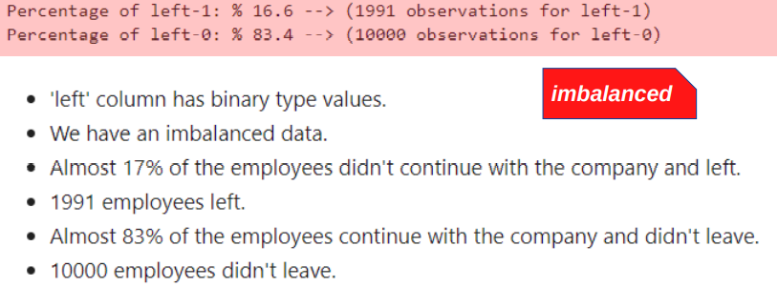
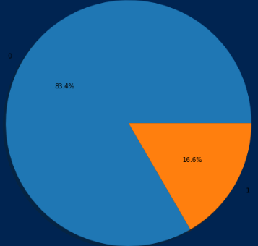
EDA (Exploratory Data Analysis )
Columns: 10 Rows: 14.999 Duplicated: 3.008 Null: None

Slide 6
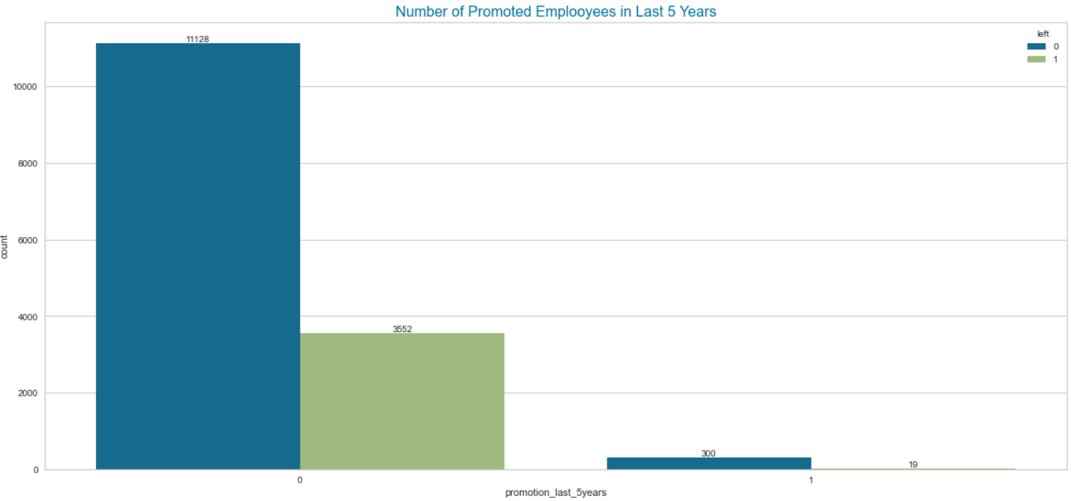
Receiving a promotion in the last 5 working years is not determinative in terms of leaving or continuing to work.
However, the percentage of those who receive promotions, even if it is small, is higher than those who do not.
Resigning rates do not have a strict relation with getting promoted.

Slide 7
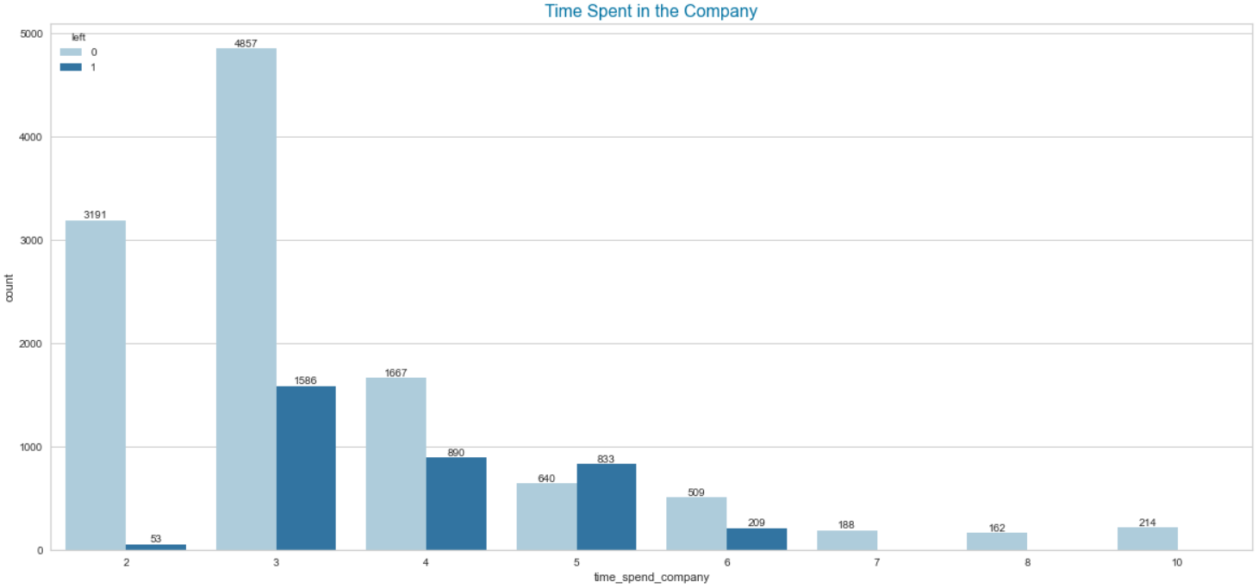
Generally, those who work between the 2nd and 6th years leave the company, especially in their 3rd year.

Slide 8
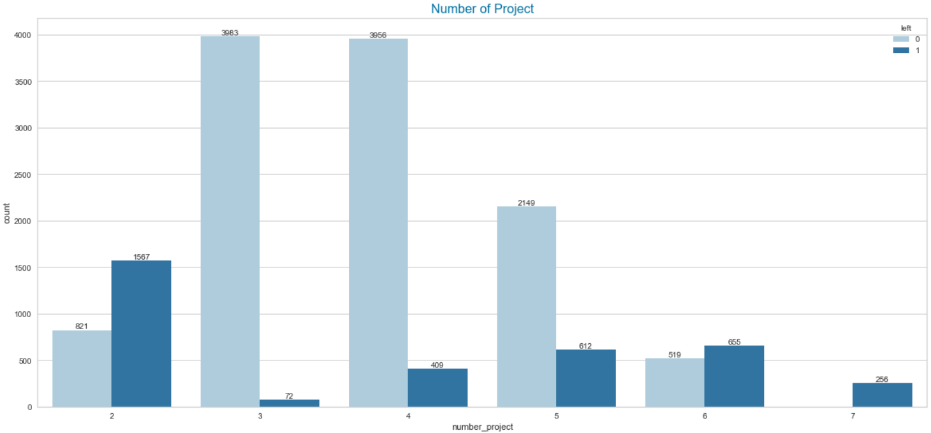
The number of leaving employees is higher among those who have only two projects during the period.
There are no ongoing staff members who were assigned to 7 projects.

Slide 9
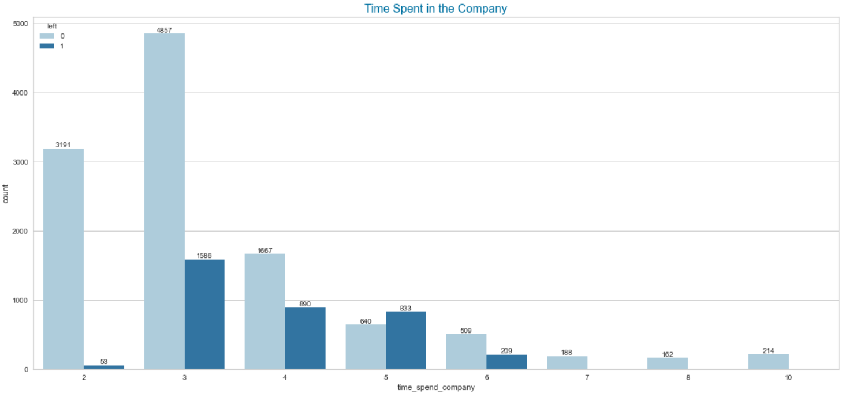

Slide 10
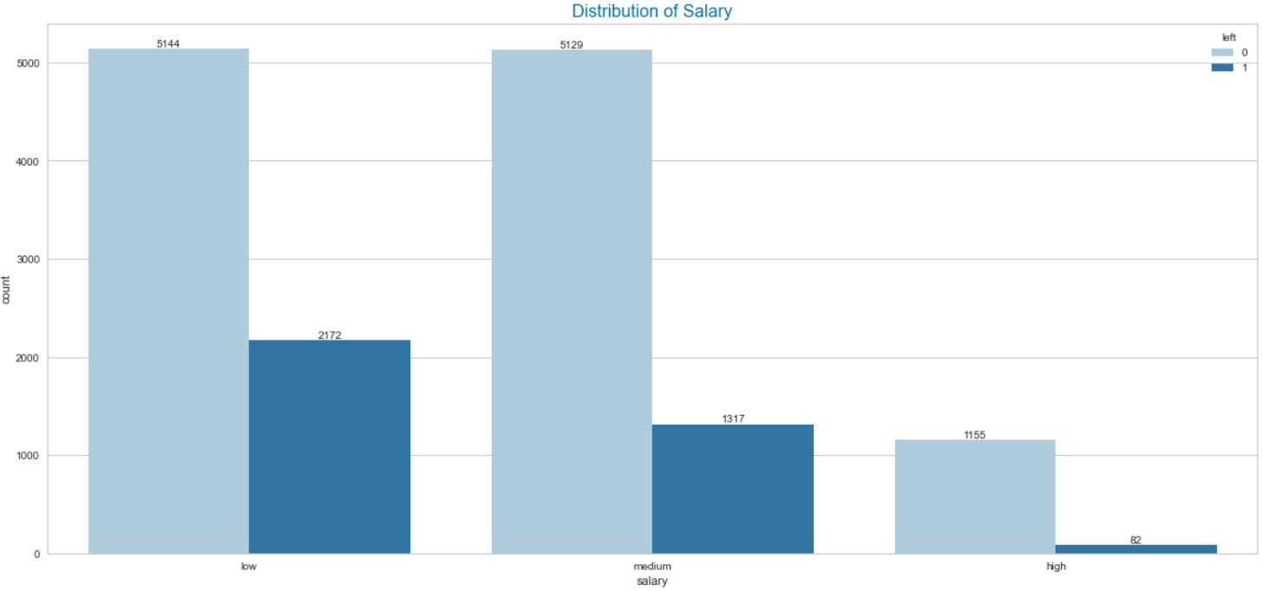

Slide 11
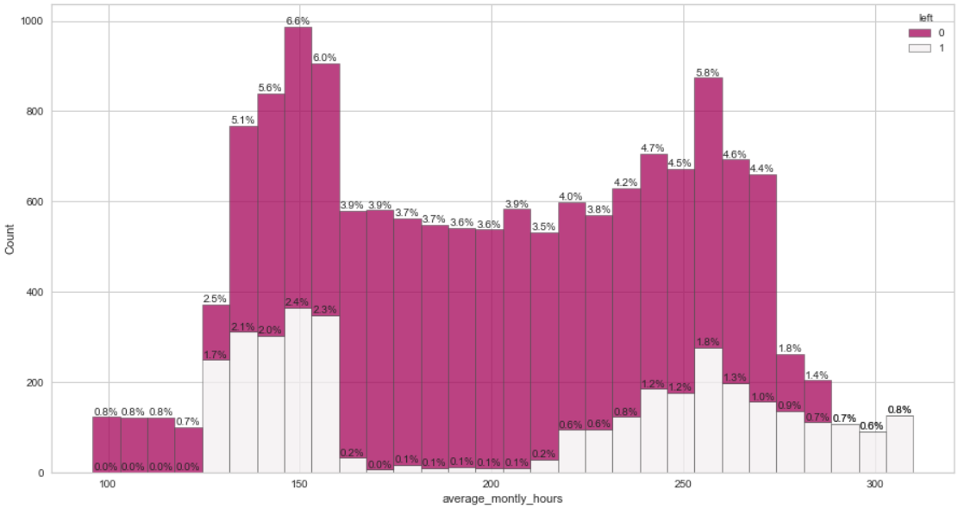
Tendency to left regarding workload has five phases
Below 125 hours/month there is no churn
125-160 hours/month churn rate is highest
160-220 hours/month churn rate very low(neglectable)
220-290 hours/month churn rate high(has a bell shape)
Over 220 hours/month churn rate % 100!!!

Slide 12
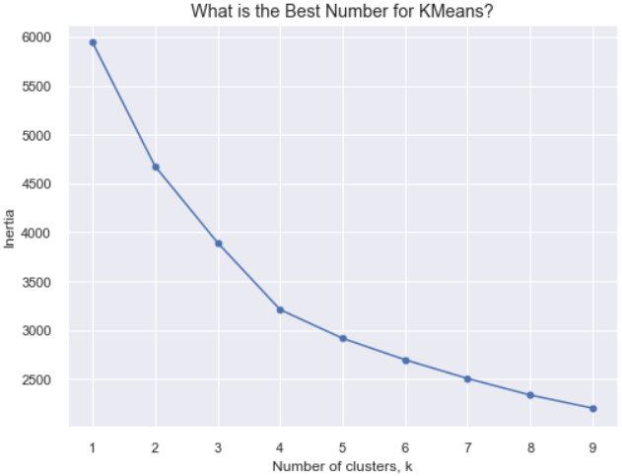
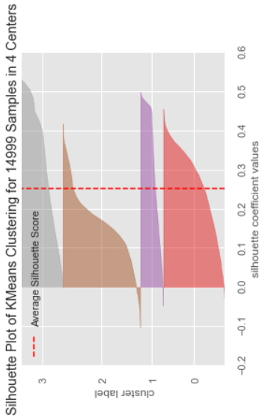
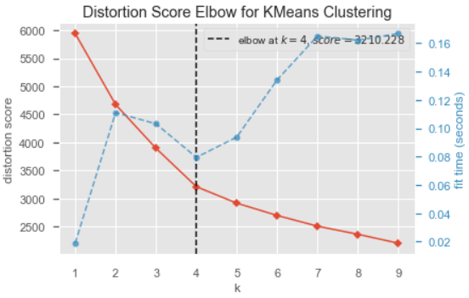
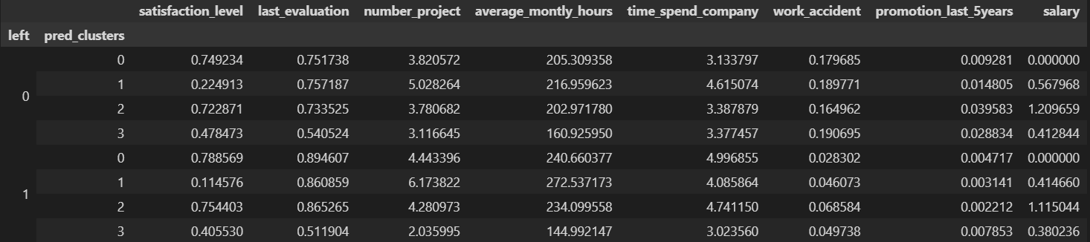
K-MEANS

Slide 13
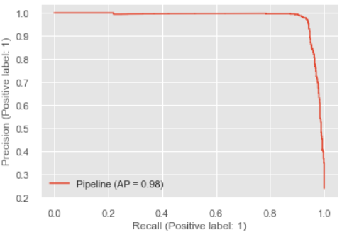
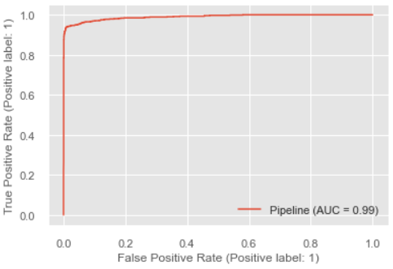
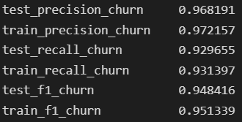
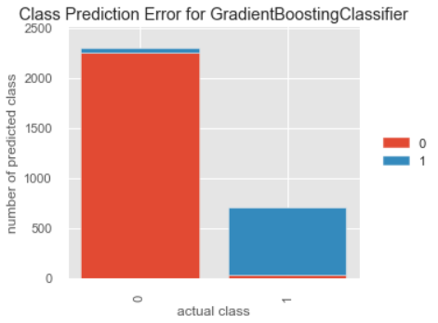
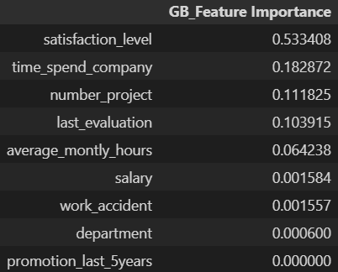
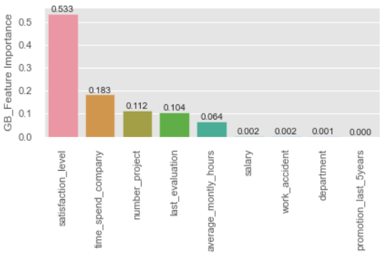
GRADIENT BOOSTING
GradientBoosting_CV

Slide 14
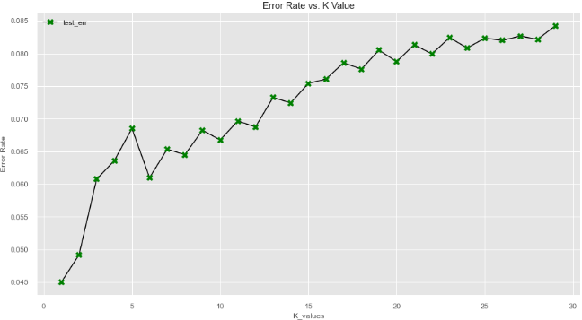
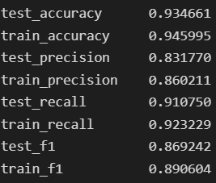
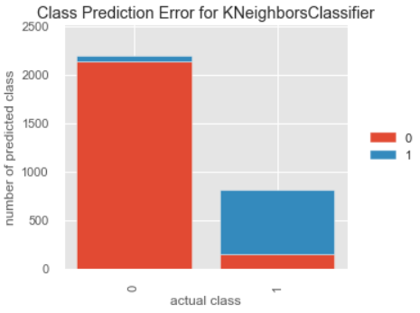
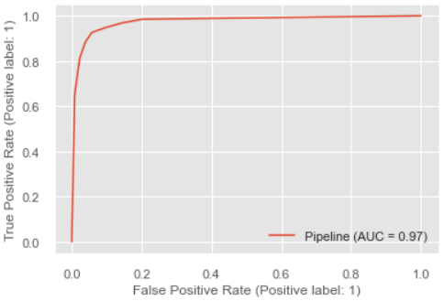
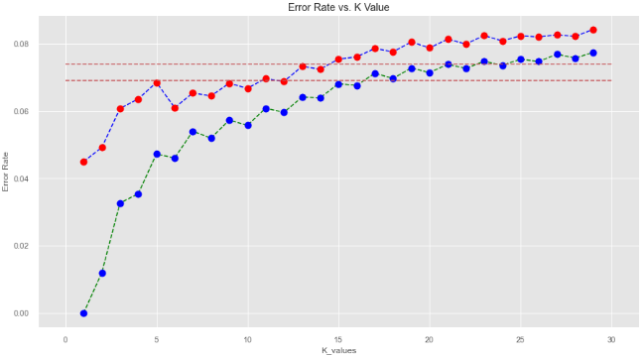
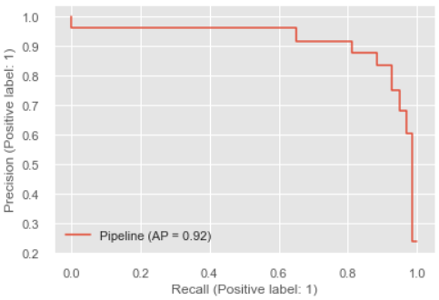
KNN

Slide 15

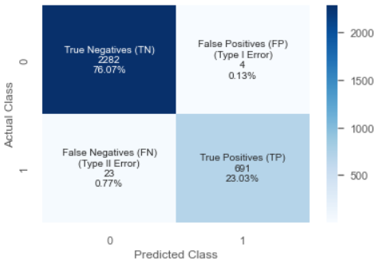
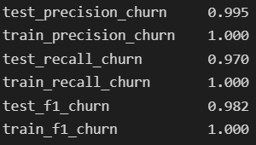
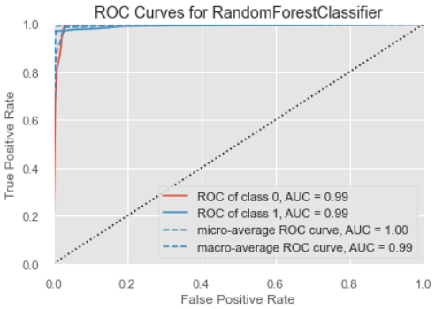
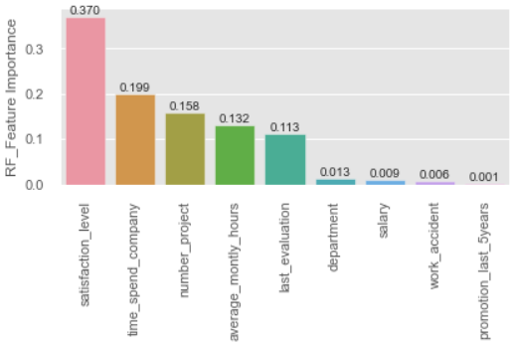
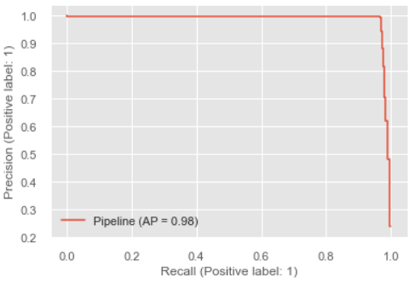
RANDOM FOREST
RD_CV

Slide 16
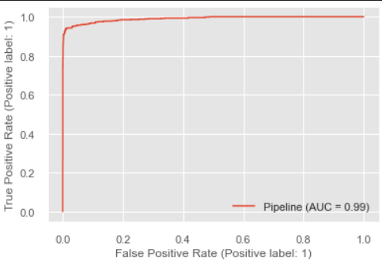
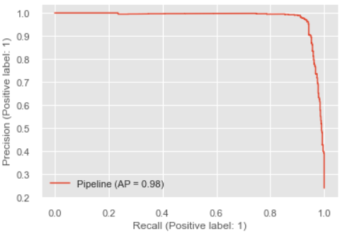
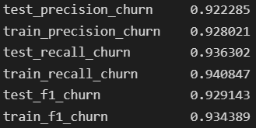
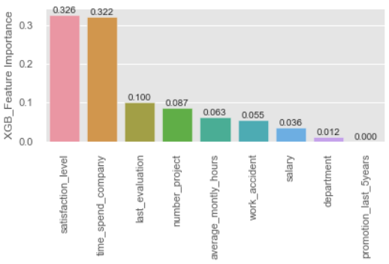
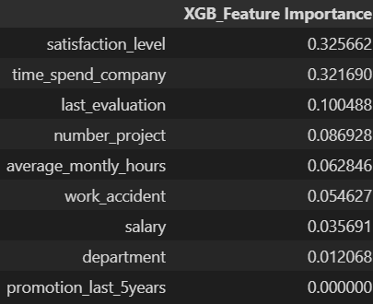
XGBOOST
XGBOOST_CV

Slide 17
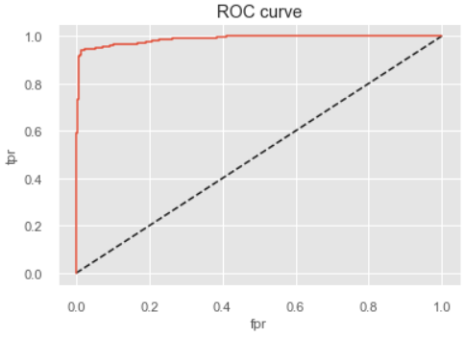
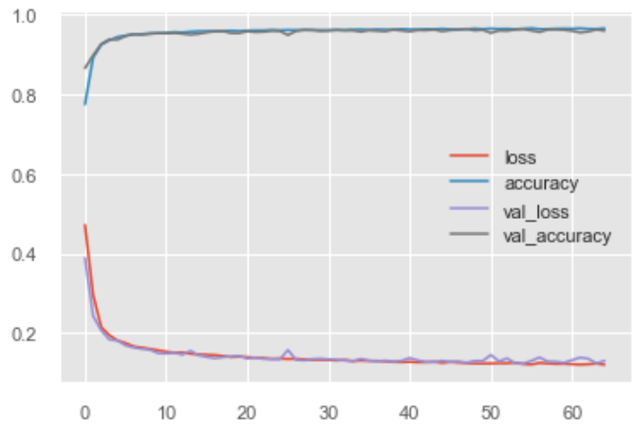
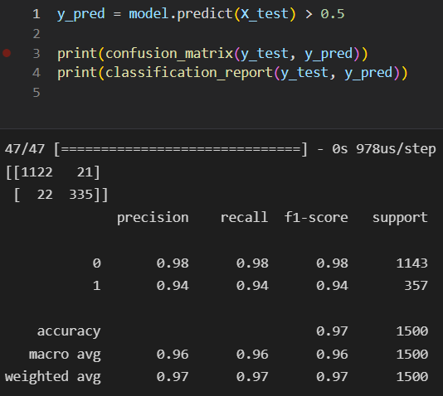
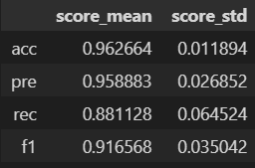

ANN

Slide 18
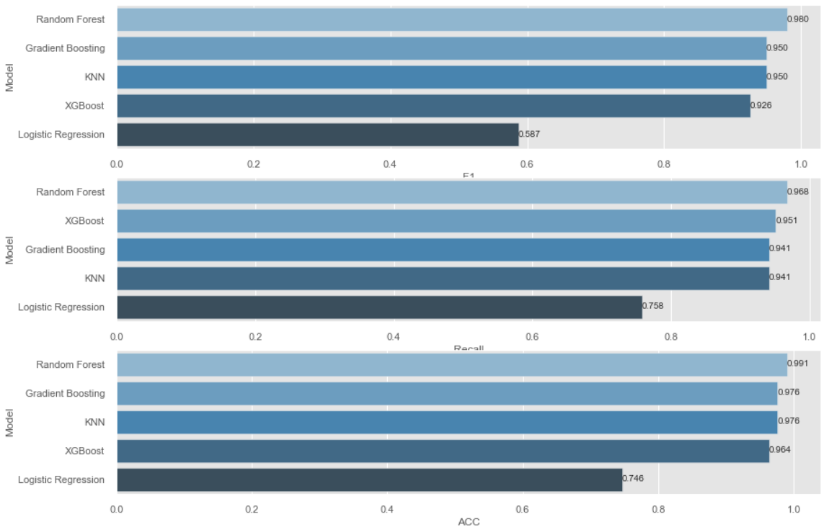
Comparing Models

Slide 19
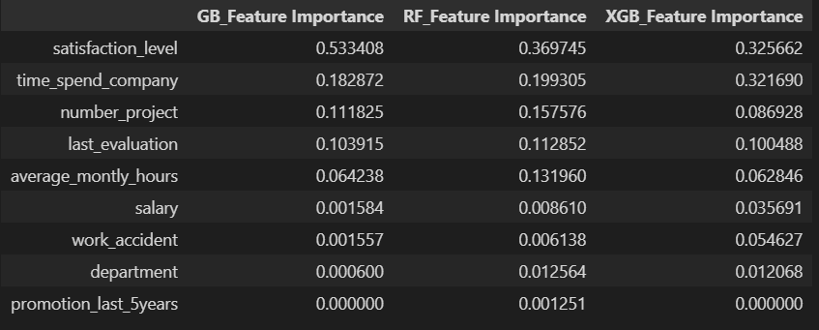
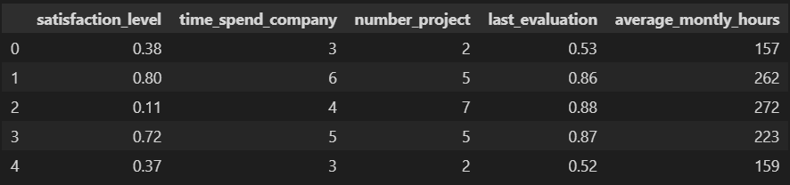
Comparing Models

